Slide 1
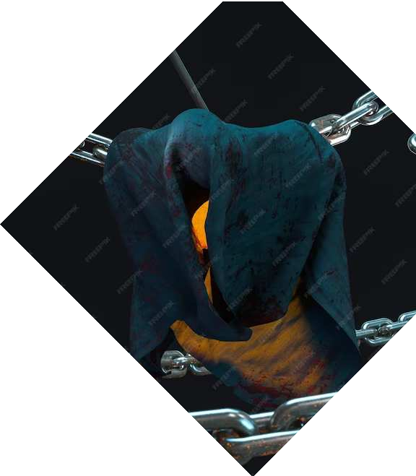
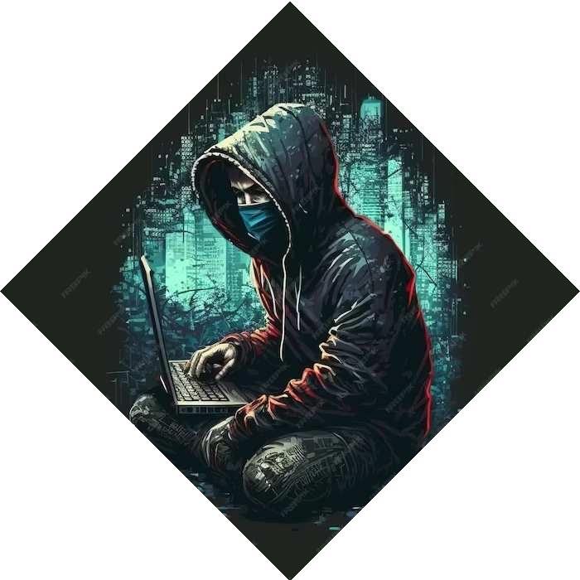
Phishing Unmasked: Safeguarding Against Deceptive Schemes and Social Engineering

Slide 2
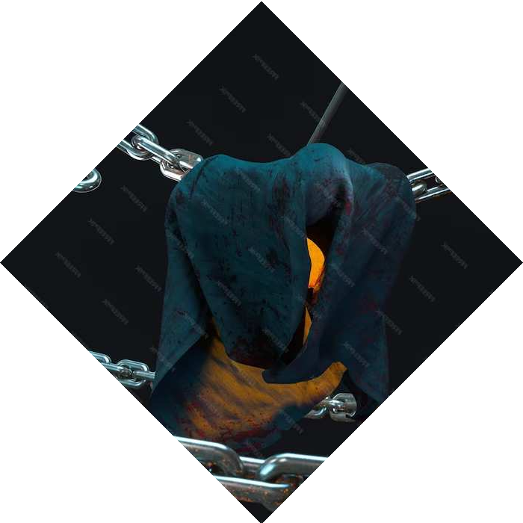
Introduction
Understanding the phishing landscape and its impact on cybersecurity. Exploring deceptive schemes and social engineering tactics. Unmasking the psychology behind phishing attacks.

Slide 3

Deceptive Emails
Identifying red ﬂags in phishing emails. Analyzing the anatomy of a deceptive email. Unveiling common tactics used by cybercriminals to lure
victims into their traps.

Slide 4
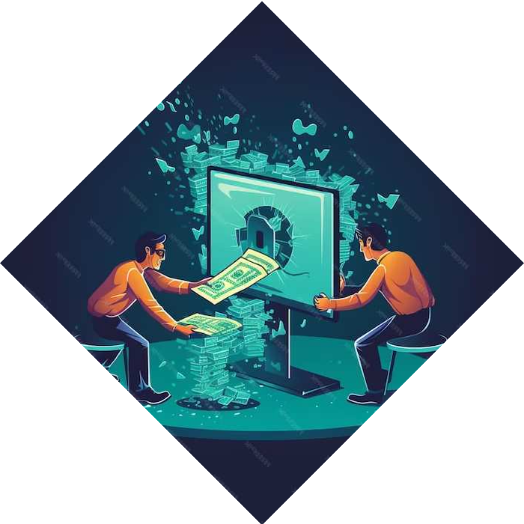
Social Engineering
Tactics
Exploring the art of social engineering. Understanding how cybercriminals exploit human psychology. Recognizing the manipulation techniques used in
phishing attacks.

Slide 5


Impersonation Techniques
Unmasking the art of impersonation in phishing attacks. Recognizing the tactics used to impersonate trusted entities. Understanding the psychology behind successful
impersonation.

Slide 6

Phishing Website
Detection
Spotting fraudulent websites through visual cues and URL inspection. Analyzing the key indicators of a phishing website. Understanding the importance of website validation.

Slide 7

Security Awareness
Training
Empowering employees through security awareness training. Building a resilient workforce against phishing attacks.
Implementing eﬀective strategies to foster a security-conscious culture.

Slide 8


Multi-Factor Authentication
Leveraging the power of multi-factor authentication to enhance security. Exploring the eﬀectiveness of MFA in
mitigating phishing risks. Implementing MFA best practices.

Slide 9



Incident Response Plan
Developing a robust incident response plan to combat phishing attacks. Understanding the key components of an eﬀective response strategy. Implementing proactive measures to minimize impact.

Slide 10

Continuous Vigilance
Emphasizing the importance of continuous vigilance against phishing attacks.
Implementing proactive monitoring and
detection measures. Nurturing a culture of cybersecurity vigilance.

Slide 11

Conclusion
Empowering individuals and organizations to stay one step ahead of phishing attacks.
Embracing a creative approach to cybersecurity. Unmasking the art of phishing and safeguarding against deceptive schemes.

Slide 12



Thanks!
Do you have any questions?
ratneshsh0978@email.com
+91 9532290097
www.wedogroup.live @_ratnesh_sharma_

